Slide 1
<First flight>
<Getting off the ground>

Slide 2
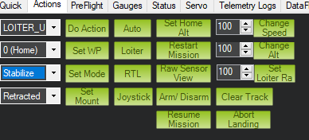
Initial steps
Place the quad on the ground for auto calibration of gyros and sensors. (RED and BLUE LED flashes means calibration combleted)
Set flight mode to stabilize in MP

Slide 3
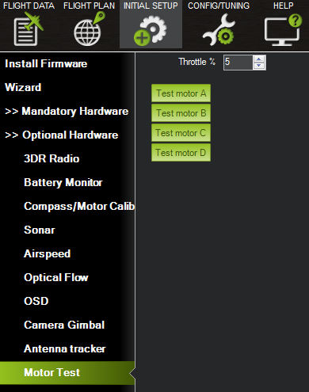
Post initial calibration
Increase throttle slightly
If it’s going to flip recheck the wiring and directions and test them in MP.
If any sticks are reversed , flip them in the RC Radio

Slide 4
Casual stuff that occurs
The copter may yaw automatically up to 30 degrees , this is normal and is autocorrected through the flight
No trimming should occur on the Transmitter side, if it’s not stable then relay the copter on a complete flat surface and recalibrate.
If all is good, you can switch to any other mode, but not before the copter is hoovering smoothely.

Slide 5
Tips
Hold the copter still and level after connecting the battery to allow the gyroscopes to initialize.
Get above ground effect, around 3-4 feet is enough on most models.
Make sure you have no trim on your Radio (the APM is what we want to trim, the radio should never get trimmed).
Copter establishes its home position at the time of arming, so arm your copter in the location you wish to designate as the home position.

Slide 6
Battery stuff
The APM 2.5 power module and PX4 have Battery voltage monitoring built in.
For APM 2 or 2.5 without power module it is HIGHLY recommended you install a Battery Voltage Monitor.
The Power module accepts a maximum input voltage of 18V (up to 4S LiPo battery) and maximum current of 90Amps.

Slide 7
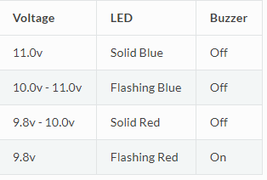

Slide 8
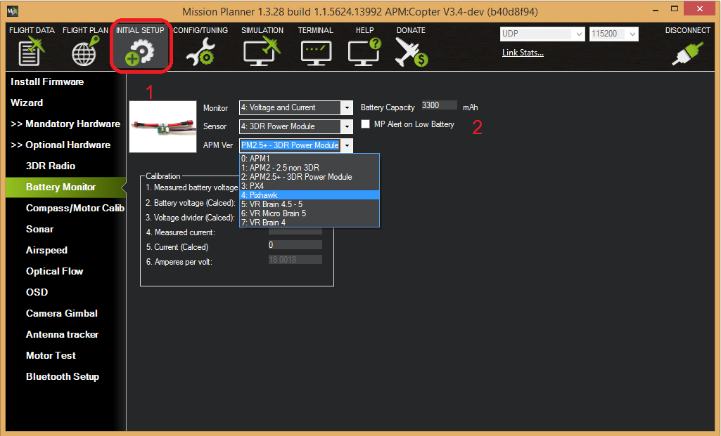
Setting up battery monitoring in MP

Slide 9
The bottom section of the the Battery Monitor screen allows you to calibrate the voltage/current measurement in order to verify that the measured voltage of the battery is correct. You can also set the Sensor selection list to Other and use the calibration process to configure an “unknown” power module.
If you find the voltage is not correct (i.e. if off from the hand-held volt meter’s reading by more than perhaps 0.2V) you can correct the APM/PX4’s reading by doing the following:

Slide 10
On Mission Planner‘s INITIAL SETUP | Optional Hardware | Battery Monitor screen set the “Sensor” to “Other”.
Enter the voltage according to the hand-held volt meter in the “Measured Battery Voltage” field
Press tab or click out of the field and the “Voltage Divider (Calced)” value will update and the “Battery voltage (Calced)” should now equal the measured voltage
Video Guide available at : https://www.youtube.com/watch?v=tEA0Or-1n18

